Slide 1
Testing levels and strategies
Course “JUnit magic”
Section 3

Slide 2
Agenda
Testing levels
Testing strategies

Slide 3
TESTING LEVELS

Slide 4
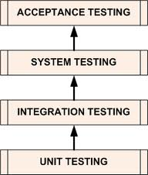
Four main testing levels

Slide 5
Unit testing
Unit Testing is a level of the software testing process where individual units/components of a software/system are tested.
The purpose is to validate that each unit of the software performs as designed.

Slide 6
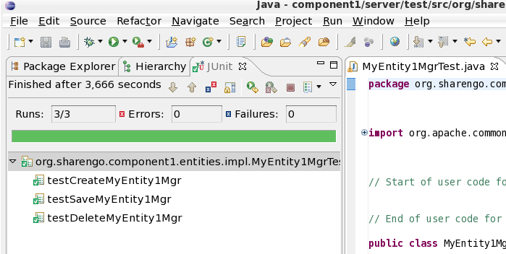
Unit testing

Slide 7
Integration testing
Integration Testing is a level of the software testing process where individual units are combined and tested as a group.
The purpose of this level of testing is to expose faults in the interaction between integrated units.

Slide 8

Integration testing

Slide 9
System testing
System Testing is a level of the software testing process where a complete, integrated system/software is tested.
The purpose of this test is to evaluate the system’s compliance with the specified requirements.

Slide 10
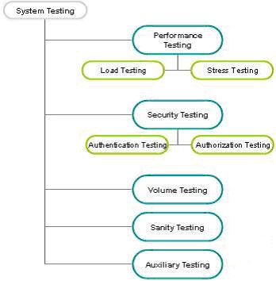
System testing

Slide 11
Acceptance testing
Acceptance Testing is a level of the software testing process where a system is tested for acceptability.
The purpose of this test is to evaluate the system’s compliance with the business requirements and assess whether it is acceptable for delivery.

Slide 12
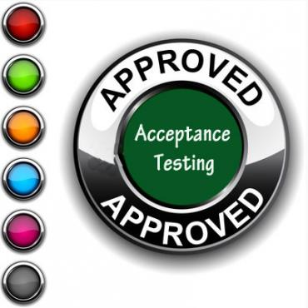
Acceptance testing

Slide 13
TESTING STRATEGIES

Slide 14
Black-box testing (1)
Black-box testing is a method of software testing that tests the functionality of an application as opposed to its internal structures or workings (see white-box testing).

Slide 15
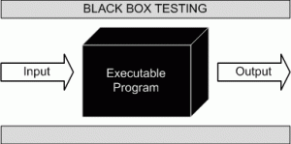
Black-box testing (2)

Slide 16
Black-box testing (3)
Specific knowledge of the application's code/internal structure and programming knowledge in general is not required.

Slide 17
Black-box testing (4)
The tester is only aware of what the software is supposed to do, but not how i.e. when he enters a certain input, he gets a certain output; without being aware of how the output was produced in the first place.

Slide 18
Black-box testing (5)
Test cases are built around specifications and requirements, i.e., what the application is supposed to do.
It uses external descriptions of the software, including specifications, requirements, and designs to derive test cases.

Slide 19
Black-box testing (6)
This method of test can be applied to all levels of software testing: unit, integration, system and acceptance.
It typically comprises most if not all testing at higher levels, but can also dominate unit testing as well.

Slide 20
White-box testing (1)
White-box testing is a method of testing software that tests internal structures or workings of an application, as opposed to its functionality (i.e. black-box testing).

Slide 21
White-box testing (2)
In white-box testing an internal perspective of the system, as well as programming skills, are required and used to design test cases.
The tester chooses inputs to exercise paths through the code and determine the appropriate outputs.

Slide 22
White-box testing (3)
While white-box testing can be applied at the unit, integration and system levels of the software testing process, it is usually done at the unit level.

Slide 23
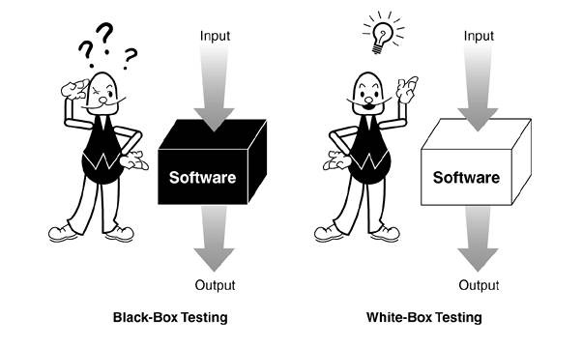
Black-box vs White-box testing

Slide 24

Any Questions?

Slide 25
References
xUnit Test Patterns: Refactoring Test Code: http://martinfowler.com/books.html
Wikipegia: http://en.wikipedia.org/wiki/Software_testing
http://www.softwareqatest.com
http://vyaskn.tripod.com/software_testing_qa_books.htm

